Slide 1


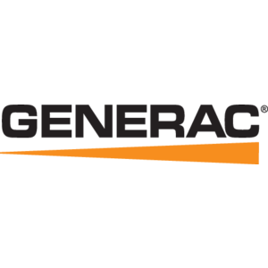


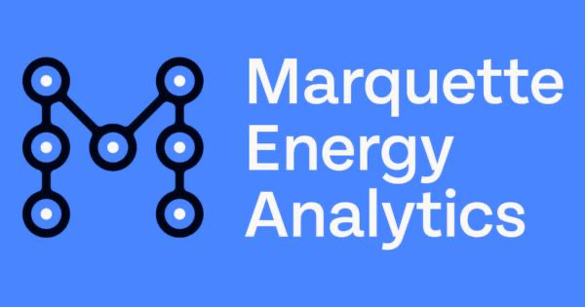








We are nvisia.
Expert partner for custom technology solutions
All consultants are full-time employees
92% of companies engage with us more than once
Impressive senior talent: average tenure is ~10 years
Presence in WI (Milwaukee, Fox Valley, Central WI and Madison)
Building on our 30-year history of client success:

Slide 2





We build more than just software—we architect future-ready solutions. Integrated expertise, layer by layer—that’s transformation from inside out
Customer + User Experience
Aligning technology with human needs
Software Architecture + Engineering
Delivering functional, high-quality products and solutions
Scalability
Modernization
Experience
Data + AI
Enabling smarter decisions and automation
DevOps + Platform Engineering
Ensuring scalability, security, and speed
Innovation
Delivery + Enablement
Upskilling teams, ensuring long-term value
Notes:
Our approach ensures that every transformation is structurally sound, scalable, and built to last. We bring expertise across:
Customer + User Experience → Aligning technology with human needs
Software Architecture + Engineering → Delivering functional, high-quality products & solutions
DevOps + Platform Engineering → Ensuring scalability, security, and speed
Data + AI → Enabling smarter decisions and automation
Delivery + Enablement → Upskilling teams, ensuring long-term value
------------------------
Integrated domains: Anchor statement & supporting concepts
This approach clearly conveys end-to-end expertise while allowing for flexibility in how different teams articulate their contributions—ensuring both consistency and creativity.
Makes it clear that no service is standalone—each flows into the next.
Leaves room for individual creativity while ensuring everyone speaks to the broader framework.
Core concept(s):
Instead of seeing the continuum as a strict step-by-step progression, it helps to think of it as a layered system where different domains of expertise span multiple phases rather than being locked into one. Each domain has a core focus but extends across multiple phases, ensuring continuity from start to finish
Message examples:
At nvisia, we help businesses evolve through an integrated transformation approach, ensuring that modernization isn’t just a project—it’s a continuous journey.
Integrated expertise: We build more than just software—we architect future-ready solutions.
Use this when:
You need to introduce what we do, and put it in the conceptual & visual context of the cube
You want to highlight the breadth of our expertise, and/or the idea of transformation from inside out
-----------------------------
Integrated domains: How we help clients achieve those three business imperatives → Layering the idea of integrated domains of expertise into the Turner’s Cube
Again, the idea is to move from foundation to abstraction and back to concrete terms again
We are ABC, because we do XYZ, which breaks out as an integrated continuum of modernization, transformation, and innovation
We apply integrated domains of expertise to our clients’ toughest challenges
From A to Z:
CX/UX connects technology to human needs; Software engineering delivers robust functionality; DevOps & platform engineering ensures scalability, security, and speed; Data provides insight to drive decisions; AI enables smarter solutions; And our delivery model prioritizes capability-building and long-term value
Message example:
Our approach ensures that every transformation is structurally sound, scalable, and built to last. We bring expertise across:
Customer + User Experience → Aligning technology with human needs
Software Architecture + Engineering → Delivering functional, high-quality products & solutions
DevOps + Platform Engineering → Ensuring scalability, security, and speed
Data + AI → Enabling smarter decisions and automation
Delivery + Enablement → Upskilling teams, ensuring long-term value

Slide 3
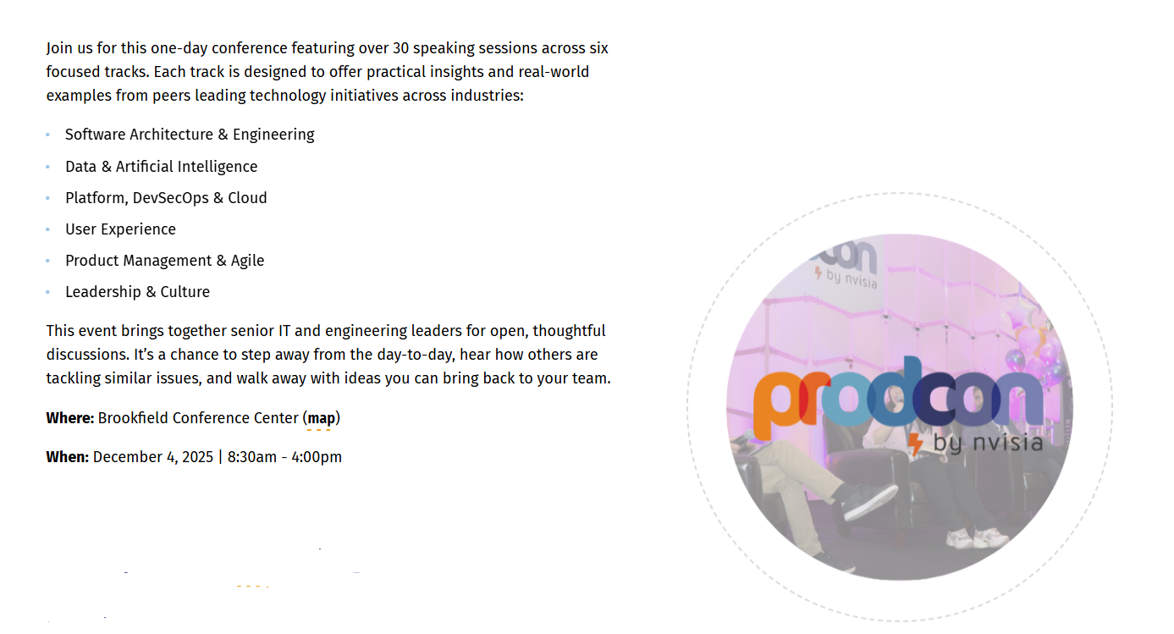
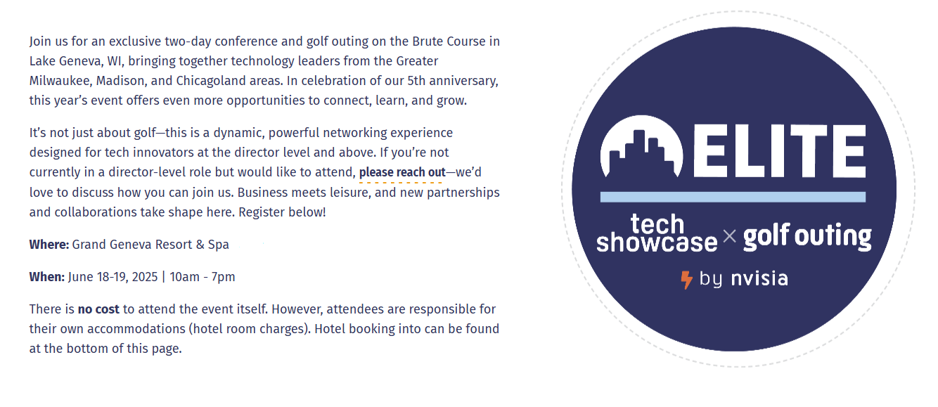

Interested in attending ProdCon?
Thank you and
next steps

